Slide 1
Section 14.2
Permutations and Combinations
Copyright © 2012 Pearson Education, Inc. Publishing as Prentice Hall.

Slide 2

Copyright © 2012 Pearson Education, Inc. Publishing as Prentice Hall.

Slide 3
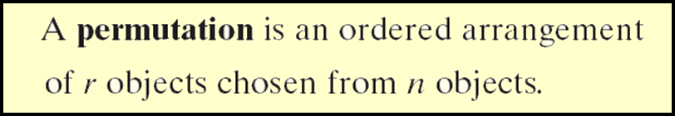
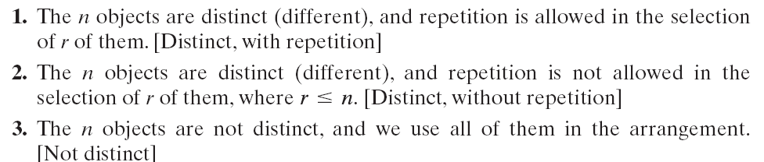
Three Types of Permutations
Copyright © 2012 Pearson Education, Inc. Publishing as Prentice Hall.

Slide 4


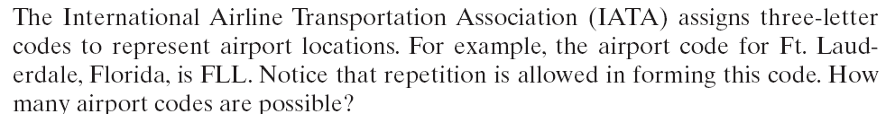


Copyright © 2012 Pearson Education, Inc. Publishing as Prentice Hall.

Slide 5

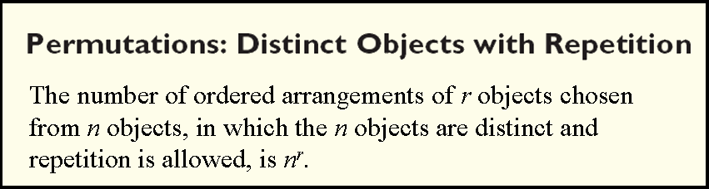
Copyright © 2012 Pearson Education, Inc. Publishing as Prentice Hall.

Slide 6

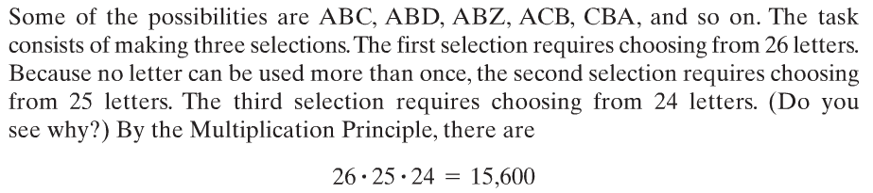
Copyright © 2012 Pearson Education, Inc. Publishing as Prentice Hall.

Slide 7
Copyright © 2012 Pearson Education, Inc. Publishing as Prentice Hall.

Slide 8

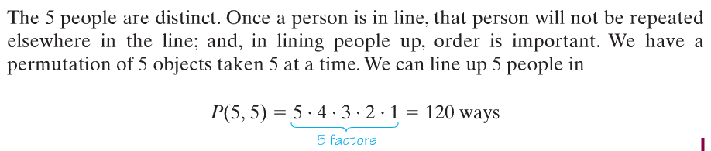
Copyright © 2012 Pearson Education, Inc. Publishing as Prentice Hall.

Slide 9
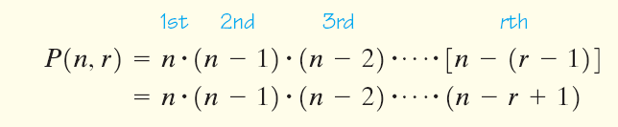
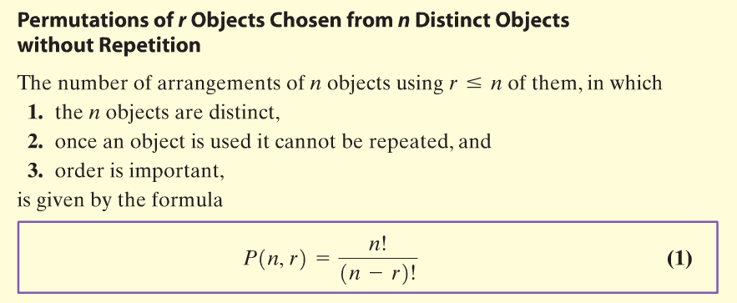
Copyright © 2012 Pearson Education, Inc. Publishing as Prentice Hall.

Slide 10

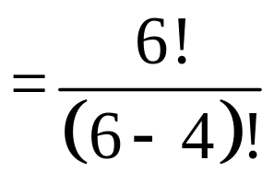
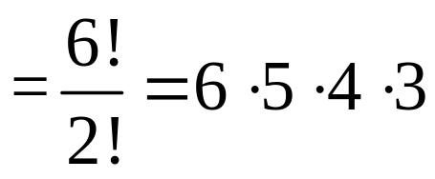

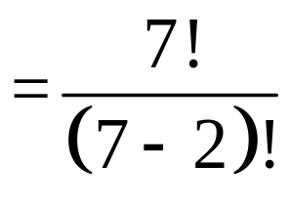
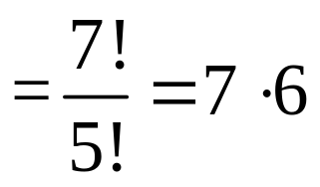


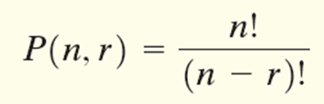
Evaluate:
(a) P(6,4)
P(7, 2)
(c) P(40, 4)
Use a calculator.
Copyright © 2012 Pearson Education, Inc. Publishing as Prentice Hall.

Slide 11

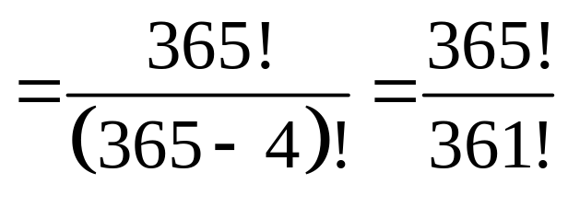
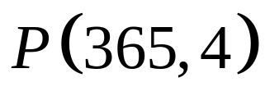
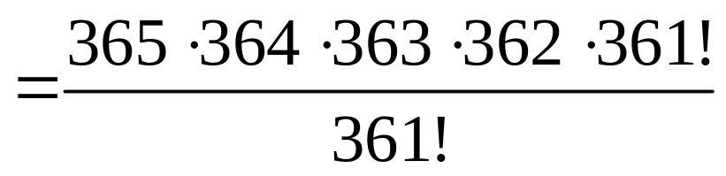
If you have a group of four people that each have a different birthday, how many possible ways could this occur?
Copyright © 2012 Pearson Education, Inc. Publishing as Prentice Hall.

Slide 12
Copyright © 2012 Pearson Education, Inc. Publishing as Prentice Hall.

Slide 13
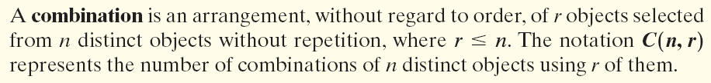
Copyright © 2012 Pearson Education, Inc. Publishing as Prentice Hall.

Slide 14

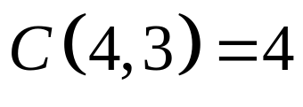
List all the combinations of the 4 colors, red, green, yellow and blue taken 3 at a time. What is C(4, 3)?
red, green, yellow
red, green, blue
red, yellow, blue
green, yellow, blue
Copyright © 2012 Pearson Education, Inc. Publishing as Prentice Hall.

Slide 15

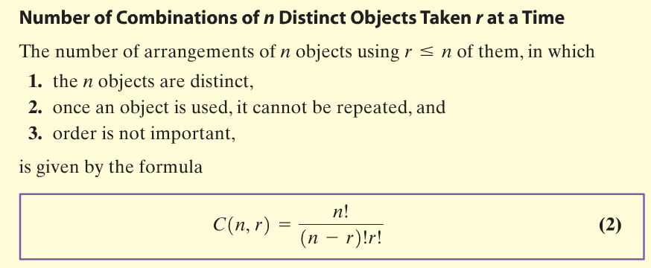
Copyright © 2012 Pearson Education, Inc. Publishing as Prentice Hall.

Slide 16

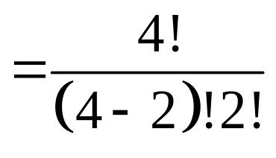
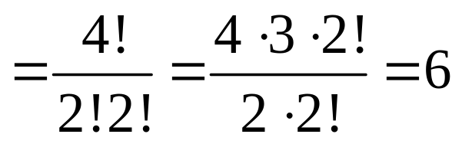
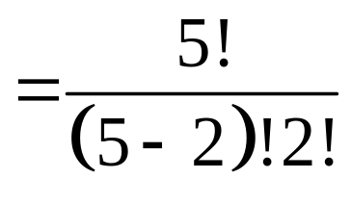
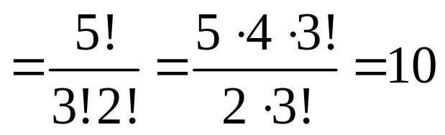
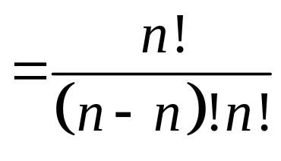

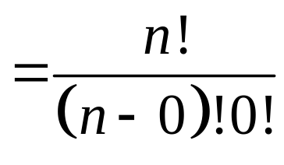

Find the value of each expression.
(a) C(4, 2)
(b) C(5, 2)
(c) C(n, n)
(d) C(n, 0)
(e) C(40, 4)
Use a calculator.
Copyright © 2012 Pearson Education, Inc. Publishing as Prentice Hall.

Slide 17

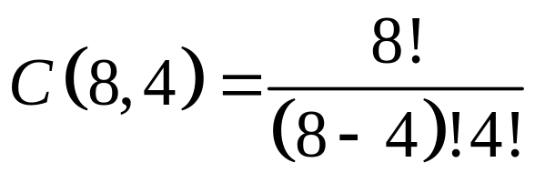
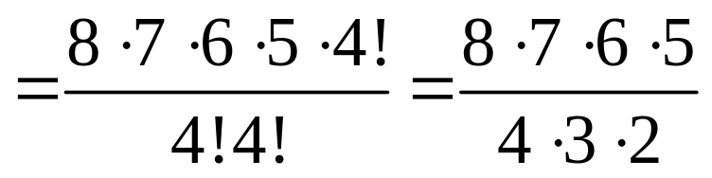

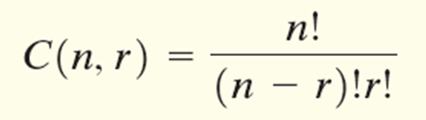
How many different committees of 4 people can be formed from a pool of 8 people?
Copyright © 2012 Pearson Education, Inc. Publishing as Prentice Hall.

Slide 18
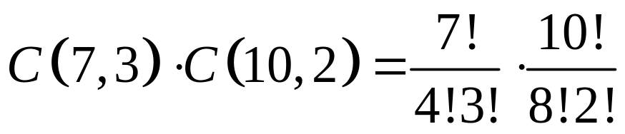
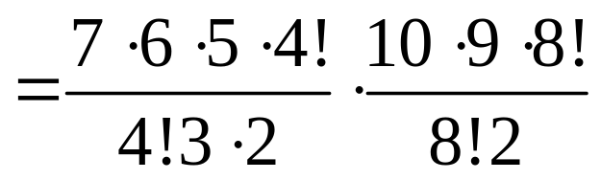


How many ways can a committee consisting of 3 boys and 2 girls be formed if there are 7 boys and 10 girls eligible to serve on the committee?
Copyright © 2012 Pearson Education, Inc. Publishing as Prentice Hall.

Slide 19

Copyright © 2012 Pearson Education, Inc. Publishing as Prentice Hall.

Slide 20
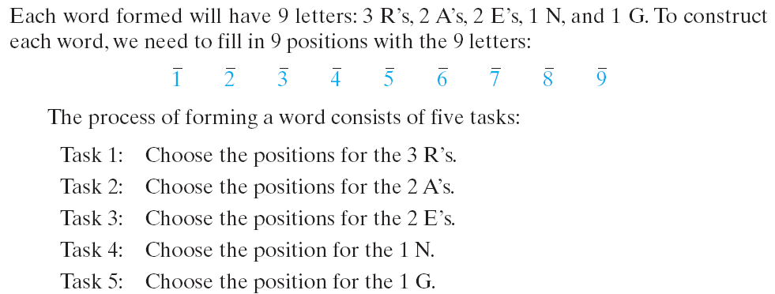
How many different words (real or imaginary) can be formed using all the letters in the word REARRANGE?
Copyright © 2012 Pearson Education, Inc. Publishing as Prentice Hall.

Slide 21
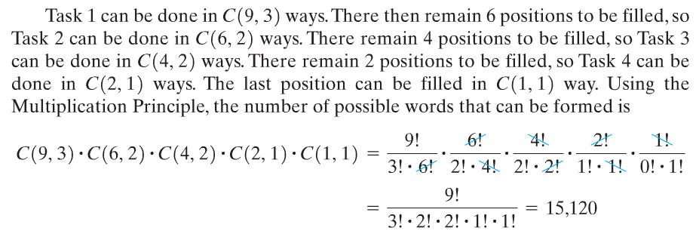
Copyright © 2012 Pearson Education, Inc. Publishing as Prentice Hall.

Slide 22
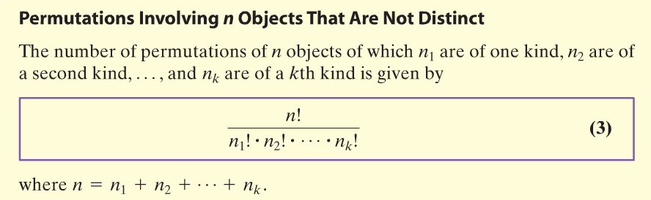
Copyright © 2012 Pearson Education, Inc. Publishing as Prentice Hall.

Slide 23

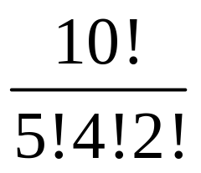
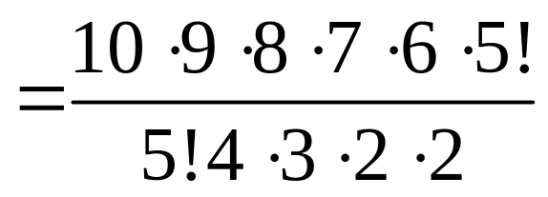

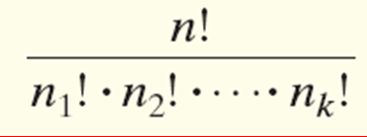
How many different vertical arrangements are there of 10 flags if 5 are white, 4 are blue and 2 are red?
Copyright © 2012 Pearson Education, Inc. Publishing as Prentice Hall.

